Slide 1
Physical Activity throughout the Lifespan
Physical Activity, Health and Wellbeing
Sandra Okwara

Slide 2
Intended learning outcomes
Discuss the importance of promoting PA throughout the lifespan.
Identify the benefits and discuss evidence supporting PA in:
Children and young people
Pregnancy and post-partum
Older people

Slide 3
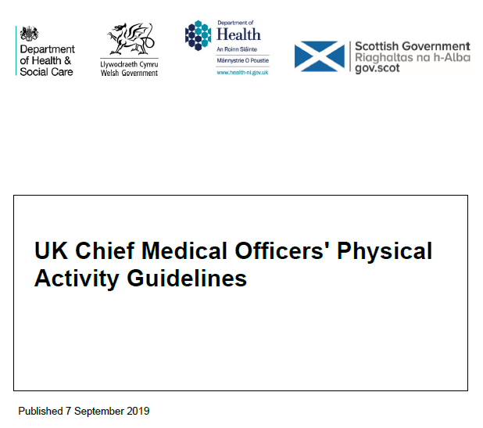
Current UK PA Guidelines
UK consensus on the amount and type of PA needed to benefit health
Summarises guidelines by age groups:
Under 5’s
Infants, toddlers and pre-schoolers
Children and young people
Adults
Older adults
Additional guidelines for
pregnant women
women after childbirth (birth – 12 months)
disabled adults

Slide 4
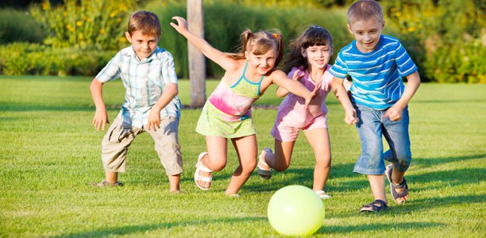
PA and children and young people (CYP)

Slide 6
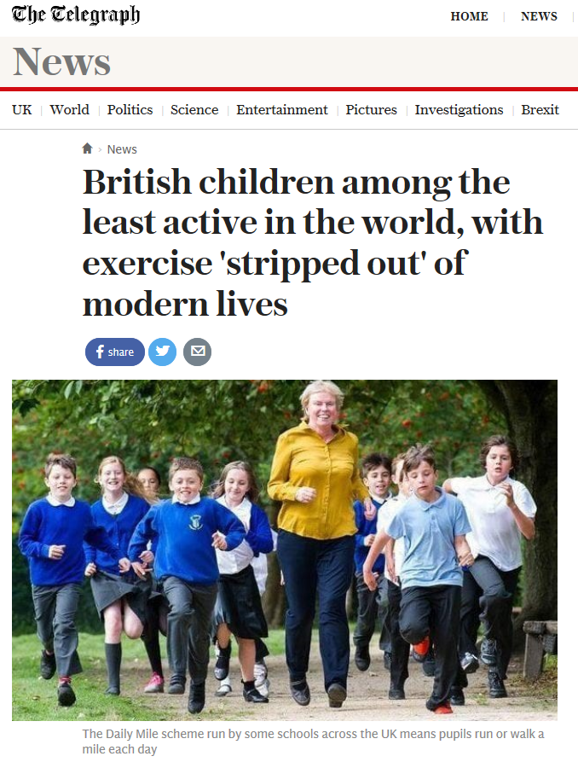
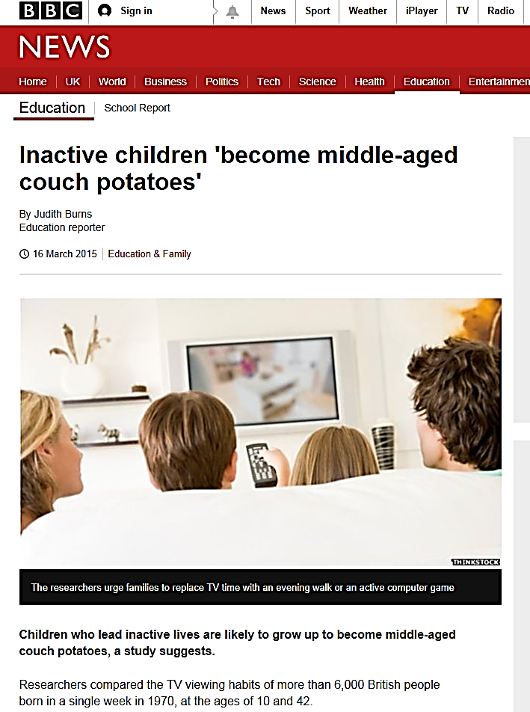
Remember lecture on PA epidemiology – PA transition

Slide 7
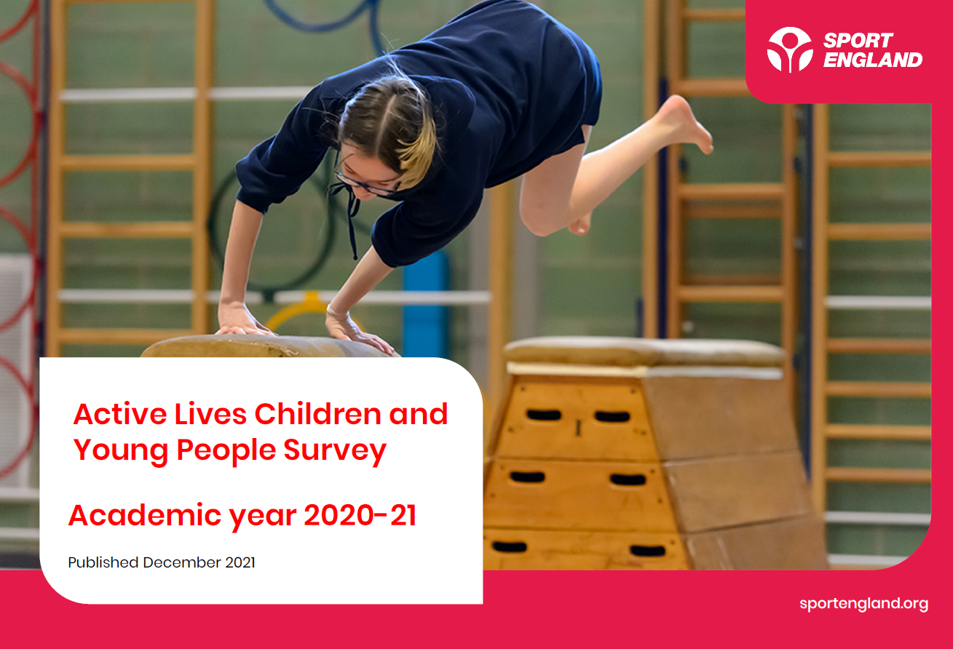

Slide 8
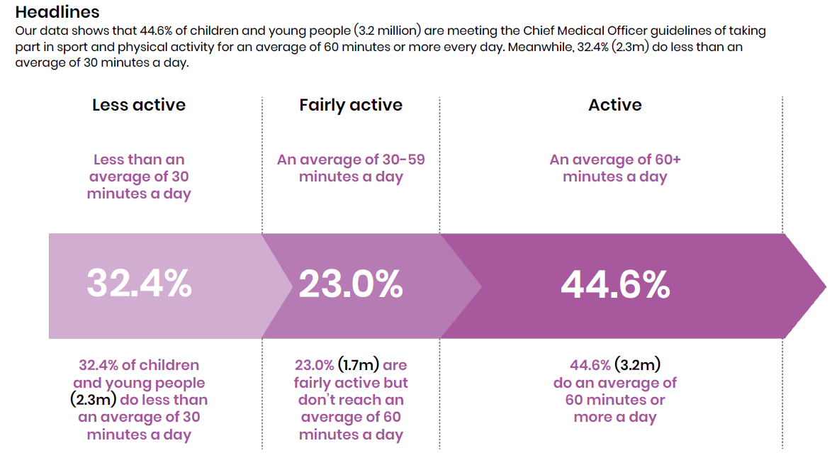
Sport England (2021) Active Lives, CYP

Slide 9
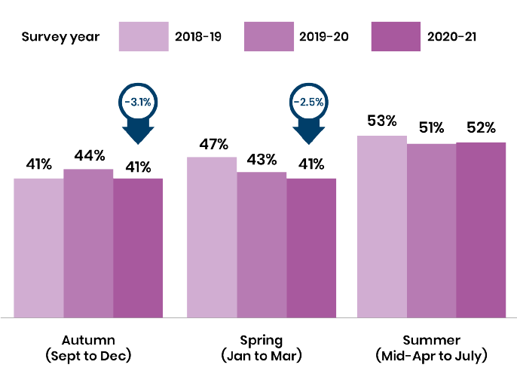
Recent seasonal activity levels (60+mins/day)

Slide 10
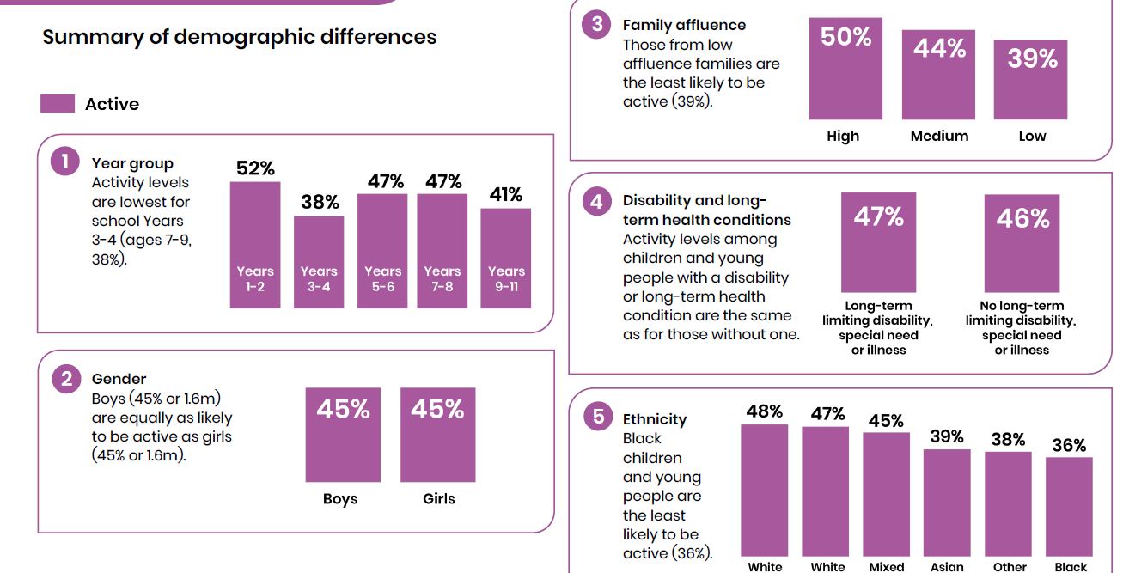
Ages 5-16 for academic year 2020-21 (Sport England 2021)

Slide 11
New recommendations
For disabled CYP, PA should be:
Completed in safe and suitable environments
Supported by appropriate professionals
Tailored and progressed (using FITT principles)
Monitored carefully for adverse effects
PA should be appropriate to the individual’s current level of physical development, fitness, physical and mental functioning, and health

Slide 12
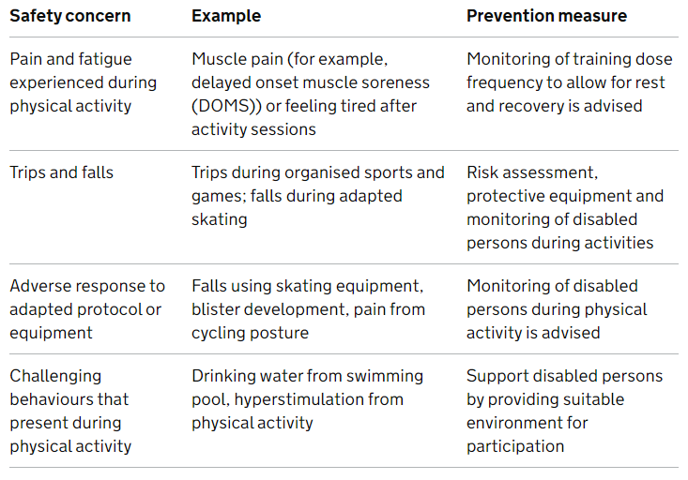
Possible risks
Pain and fatigue during PA
Trips and falls
Adverse response to adapted protocols or equipment
Challenging behaviours that present during PA

Slide 13
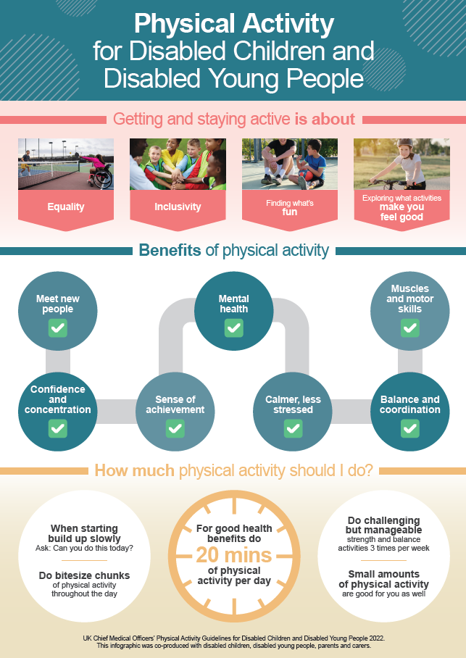

Slide 14
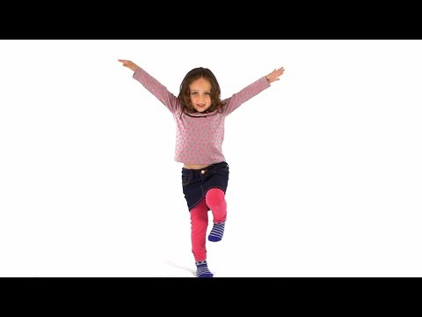
Physical literacy

Slide 15
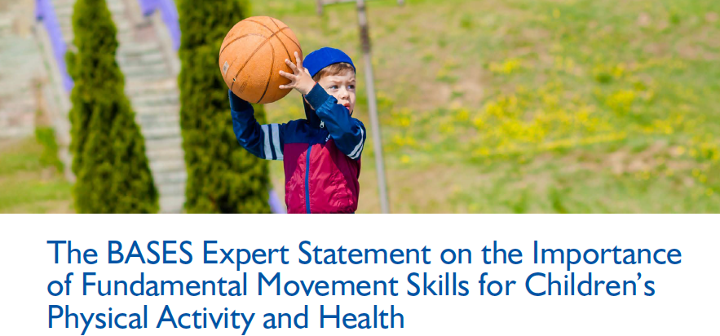
Fundamental Movement Skills (FMS)
Developing FMS provides a foundation for more advanced, complex movements needed to successfully participate in sports and activities across the lifespan
Locomotor skills (e.g., running, jumping)
Object control (e.g., throwing, catching)
Stability (e.g., balancing, twisting)
Development of FMS across childhood and adolescence plays an important role in promoting health-enhancing PA
Better FMS is related to higher levels of PA
Better FMS is related to healthier weight
Positive trajectory for future PA levels
Interventions needed to overcome low FMS competency – structured and non-structured
BASES (2020) – on Blackboard

Slide 16
Physical activity for CYP
Relationship between PA and health of children well established
Decreased;
Risk of CVD
Body fat (waist circumference and fat mass) and therefore obesity
Depression and anxiety
Type-2 diabetes risk
Increased;
Bone health
Metabolic health
Self-esteem
Cognitive performance
Academic achievement
McArdle, Katch and Katch (2015)

Slide 17

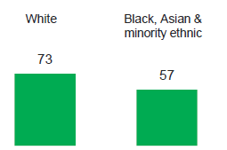
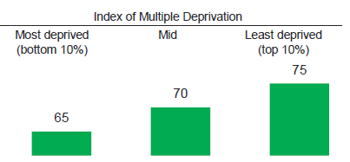
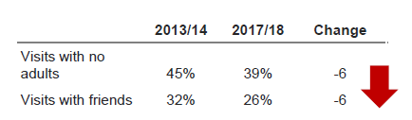
Natural England 2019 survey on CYP and the natural environment
BAME children and children from low SES are less likely to spend time outdoors than white children and higher SES children
Children’s time outside without adult supervision has declined since 2013

Slide 18
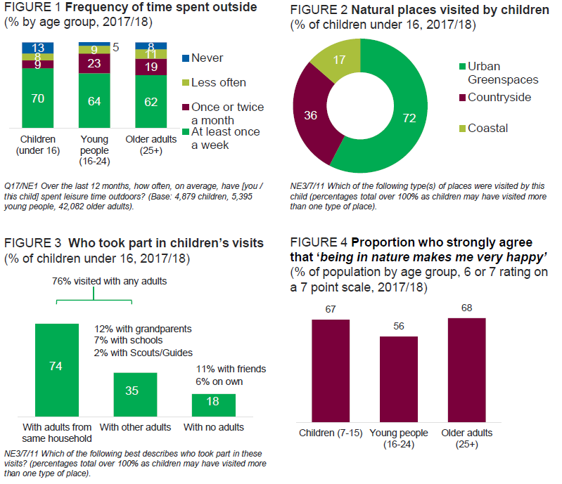
Natural England 2019 survey on CYP and the natural environment

Slide 19
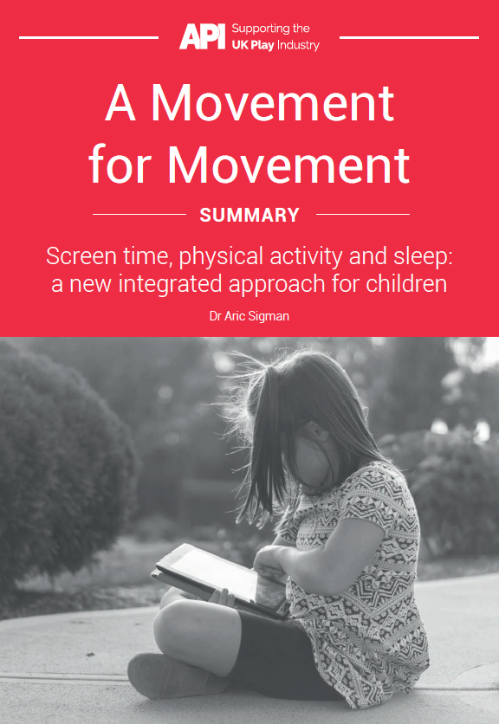
The importance of play
British children have high levels of body fat, type-2 diabetes, mental illness, sleep deprivation and sedentary behaviour
Children are 2-3 times more active when outdoors
Outdoor play is associated with better social skills in pre-schoolers
7-14 year olds are less likely to have peer relationship problems
Unstructured ‘free play’ can burn more calories than school sports programs
Association of Play Industries (Sigman, 2019)

Slide 20
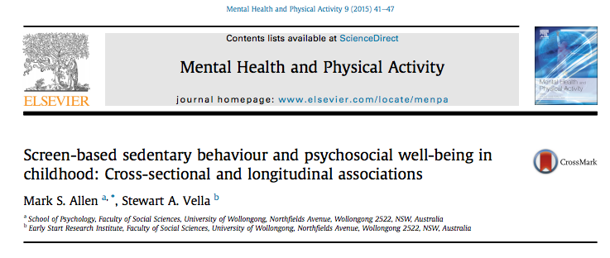

4,000 6 years olds
4,000 10 year olds
2 year follow up
High screen time was related to the development of emotional symptoms in young children
Related to hyperactivity and conduct problems in older children
Associations were stronger for those from lower socioeconomic status
Notes:
Prosocial behavior (is kind to younger children)
Hyperactivity (easily distracted)
Emotional symptoms (often seems worried)
Peer problems (tends to play alone)
Conduct problems (steals from home)

Slide 21
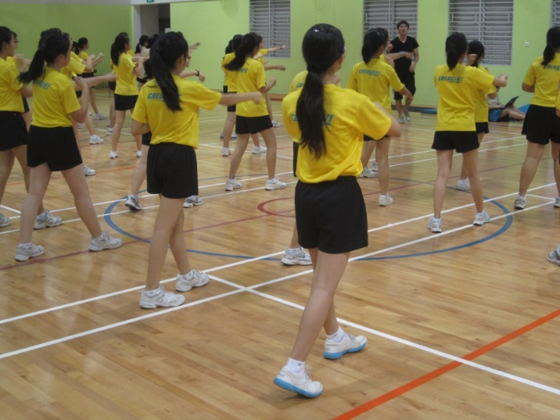
Interventions by gender
Girls less active than boys
Most effective interventions for girls were in a school setting with enjoyable PE being one of the most effective (pre-adolescent and adolescent)
(Camacho-Minano et al., 2011) NB US studies
Interventions targeting girls only seem most effective with both pre-adolescent and adolescent girls
(Pearson et al., 2014)

Slide 22
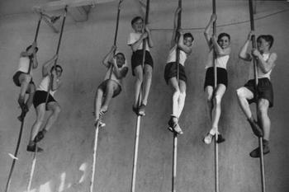
Interventions by setting – school
Most common setting is the school
Outcomes
Rates of PA: % engaged in MVPA
Duration of PA: time spent in MVPA
Limited evidence that school based interventions are effective in increasing rates and duration of MVPA
Effects more obvious in younger children
(Dobbins et al., 2013)

Slide 23
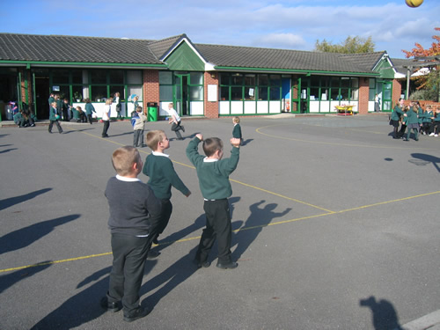
Interventions by setting – playground Ridgers et al. (2007)
15 schools in deprived areas in England
Painted areas;
Red: sports zone
Blue: multi-activity zone
Yellow: quiet zone
Intervention and control groups
Heart rate monitors and accelerometers measured intensity and duration
Intervention group had increased time spent in MVPA

Slide 24
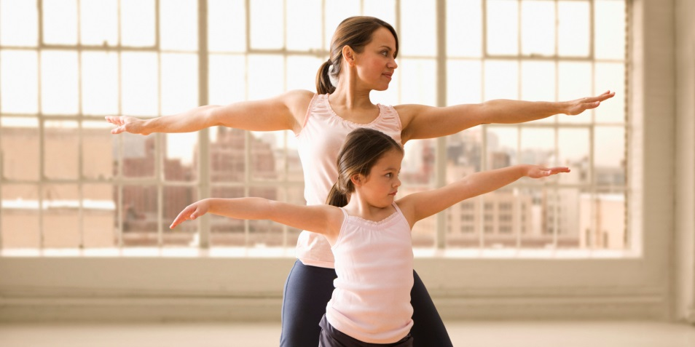
Interventions by setting – families
Evidence limited
NICE review evidence 2 RCTs found family based interventions can increase PA in children
Key factors of successful family interventions;
Located in the home
Involved information packs
GMs / mothers and daughters exercising together
We need to further understand;
Different family structures
Norms and cultures
Role of parents and grandparents
(Van Sluijs et al., 2011)

Slide 25
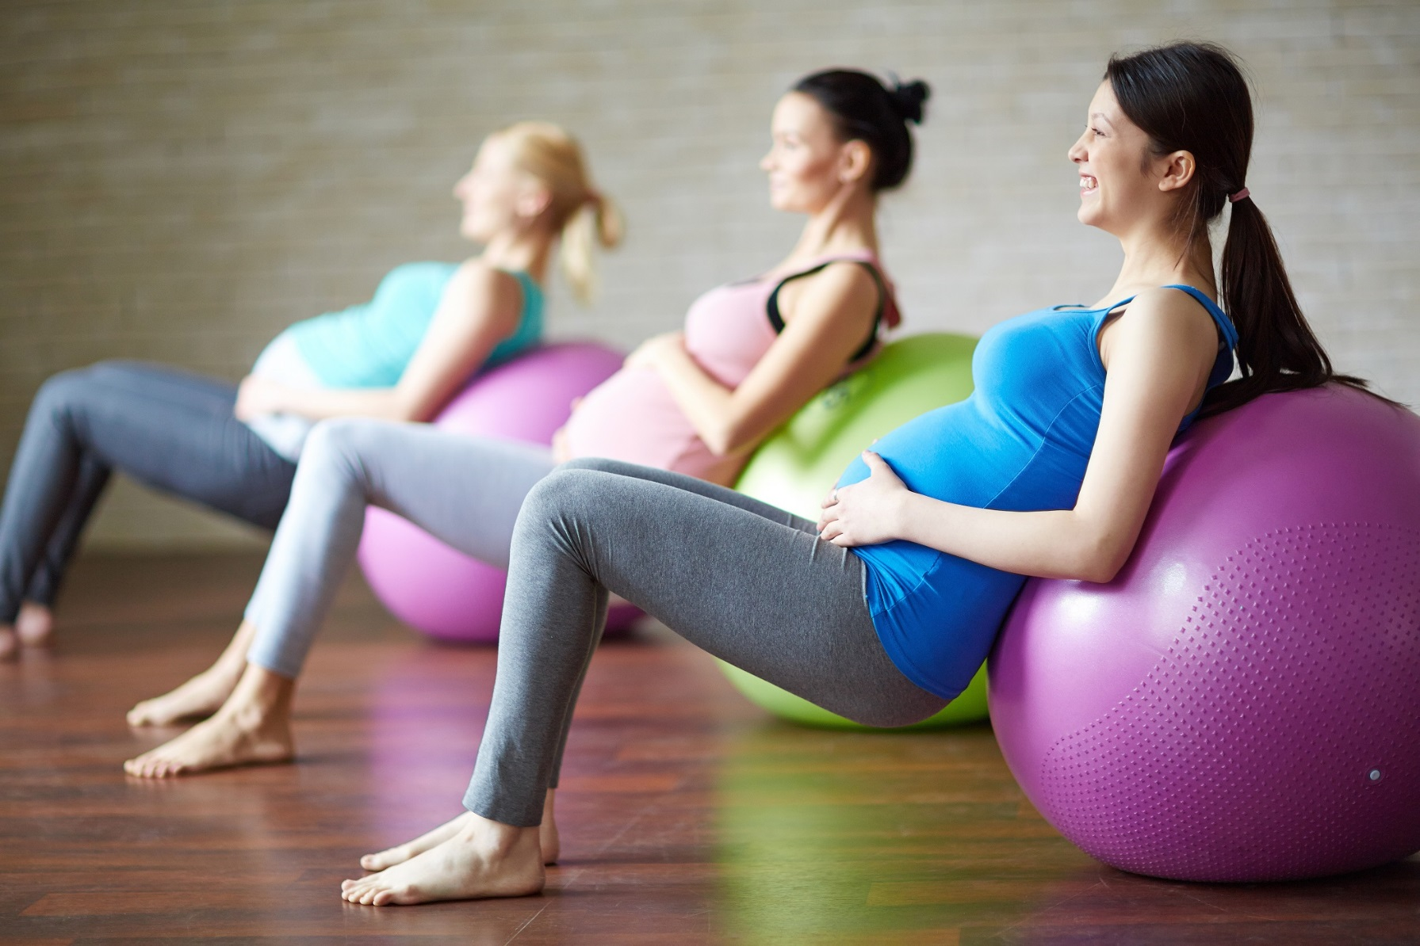
PA and pregnancy

Slide 27
PA and pregnancy guideline development
Previous PA guidelines omitted pregnant women
CMOs tasked a ‘PA Expert Committee’ to devise the guidelines and infographic we now have in the 2019 version
Objective FITT principle advice now in place for pregnancy and the postpartum period
Benefits noted include improved cardiovascular fitness and reduction in risk of gestational diabetes and excessive gestational weight gain
No systematic reviews have identified adverse maternal or infant outcomes
Smith et al. (2018)

Slide 28
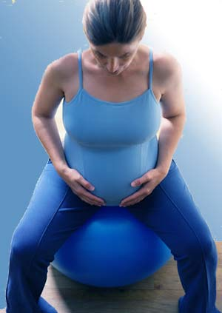
PA and pregnancy – benefits
Physical - reduction in hypertensive disorders, lower risk of gestational diabetes, varicosities, lower gestational weight gain, pre-eclamptic toxaemia, back pain, body fat
Psychological – anxiety, depression
Foetal outcome
Pregnancy experience - labour length reduced, analgesic requirements and delivery complications
NB, these benefits are in addition to those general PA benefits experienced by adults
Royal College of Obstetricians and Gynaecologists statement January 2006

Slide 29
PA and pregnancy – benefits
Healthy pregnant women are encouraged to exercise throughout their pregnancy
Health benefits to the mother and the child
Certain contraindications and considerations
ACSM (2012)

Slide 30
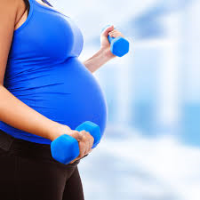

Key points re PA and pregnancy
Encourage aerobic and strength conditioning as part of healthy lifestyle
Support reasonable goals but not peak or competition
Minimise risk of loss of balance or foetal trauma
Avoid contact or risky sports
Moderate exercise is beneficial and not harmful to foetus or mother
Postpartum exercise reduces incontinence
Lactation unaffected by moderate exercise

Slide 31
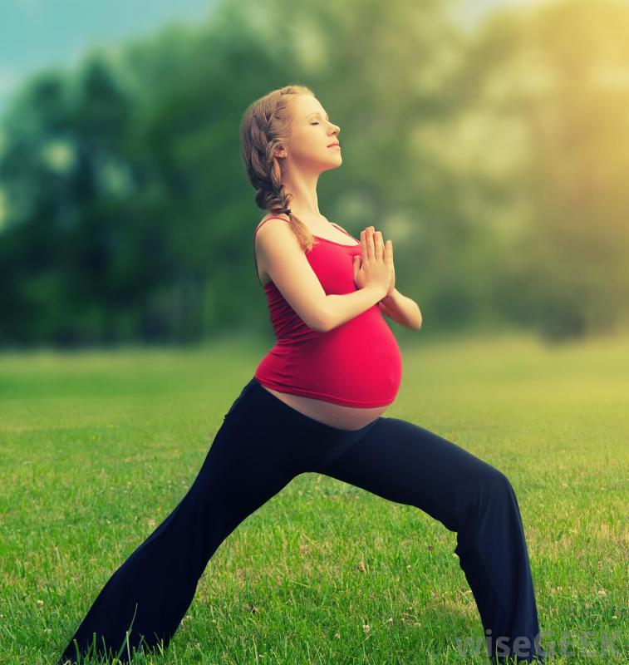
Yoga reduces stress in pregnancy (Bershadsky et al., 2014)
90 mins Hatha Yoga, 51 women
Lower cortisol
Positive affect higher
Contentment higher
Fewer postpartum depressive symptoms

Slide 32
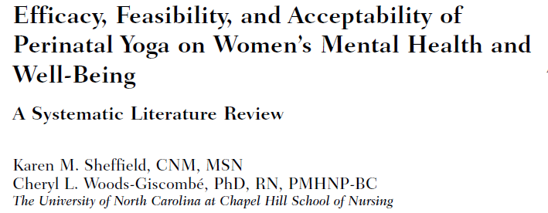
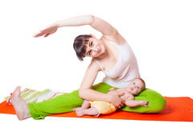
2016 research -13 studies, 7 RCTs
Several types of yoga studied
Findings – use of yoga in the perinatal period improves mental health and wellbeing for women and infants

Slide 33
PA postpartum
Regular PA during pregnancy can establish health behaviour beyond childbirth (Reid et al., 2017)
During breastfeeding, women may lose up to 10% of bone mineral density.
Resistance exercise can slow BMD loss during lactation
Colleran et al. (2019)

Slide 34
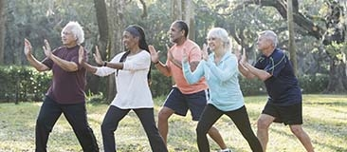
PA and older adults

Slide 35
Physiology of ageing and impact on PA
Structural and functional decline in ageing
Most systems affected
Many affect physical performance or ‘fitness’
Decline in aerobic capacity
Osteoarthritis
Osteoporosis
Accumulation of body fat
Redistribution of fat – abdominal/visceral deposits
Sarcopenia
Loss of muscle mass after age 50
0.5-1% per year
ACSM (2009)

Slide 36
Prevention and management of disease in older people
Coronary heart disease
Stroke
Increased blood pressure
Late onset (Type 2) diabetes
Osteoporosis
Colon cancer
Weight control
Reduction in accidental falls
McArdle, Katch and Katch (2015)
Effects apparent even among those taking up
activity at a later age.

Slide 37
Psychological benefits of PA for older people
Reduction in stress and anxiety
Reduction in depression
Improvement in overall psychological well-being
Improvements in cognitive function
Improvements in self-esteem and self-worth
Reduction in isolation and loneliness
Up to a 30% lower risk of dementia
McArdle, Katch and Katch (2015)
Effects apparent even among those taking up
activity at a later age.

Slide 38
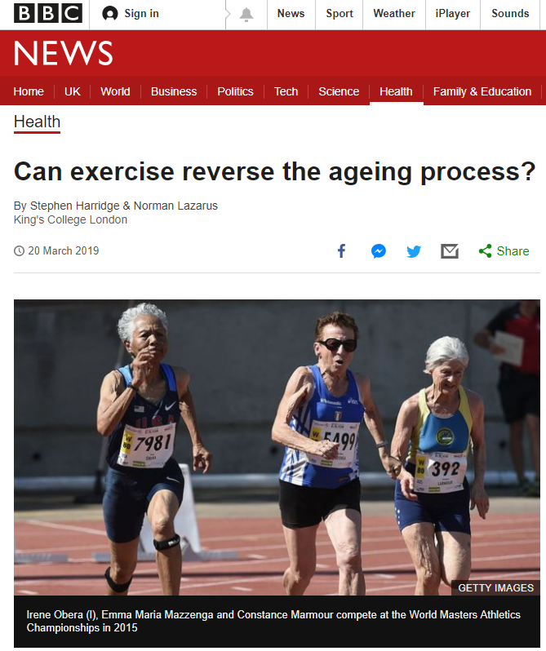
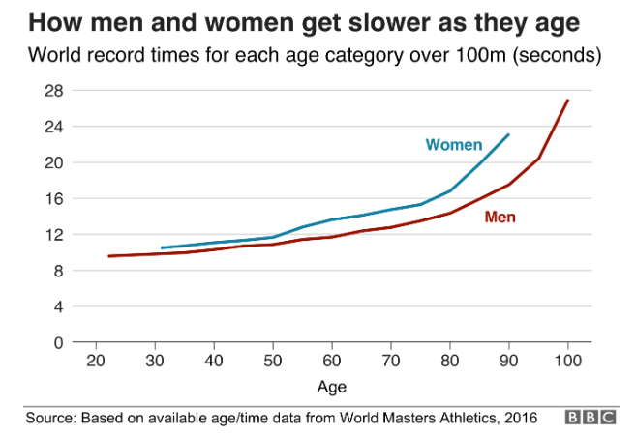
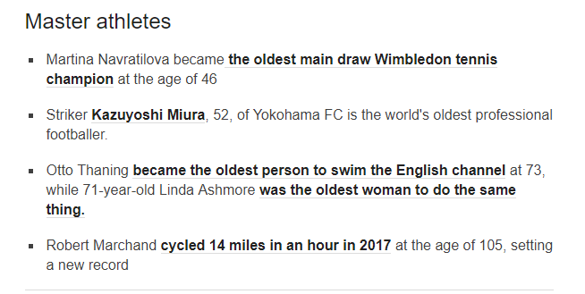

Slide 39
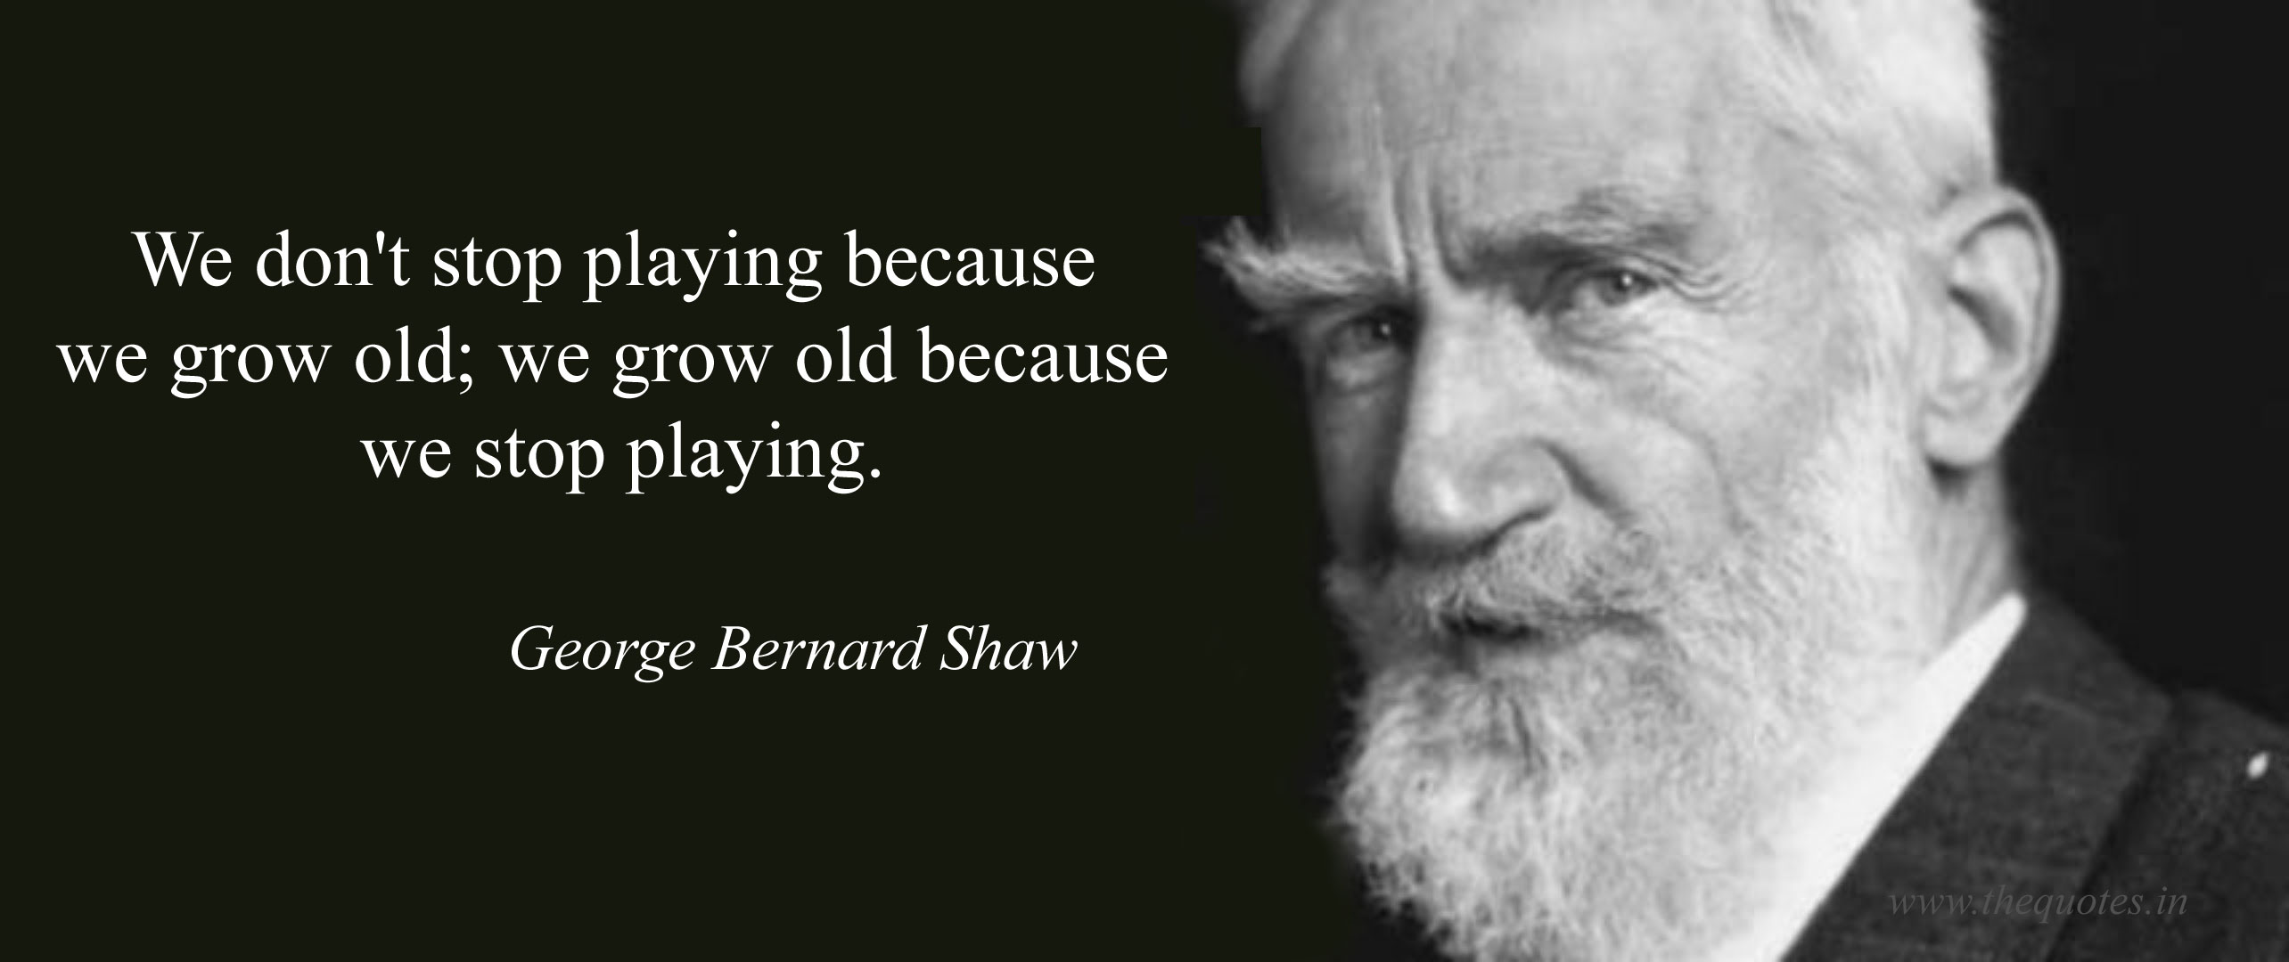

Slide 40
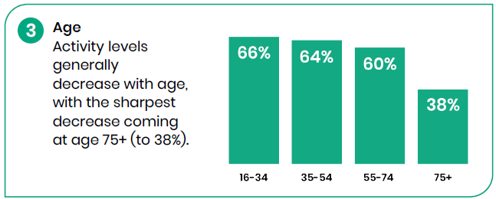
Sport England (2021) Active Lives, Adults Survey Percentage of people achieving 150+ minutes of PA/week

Slide 41
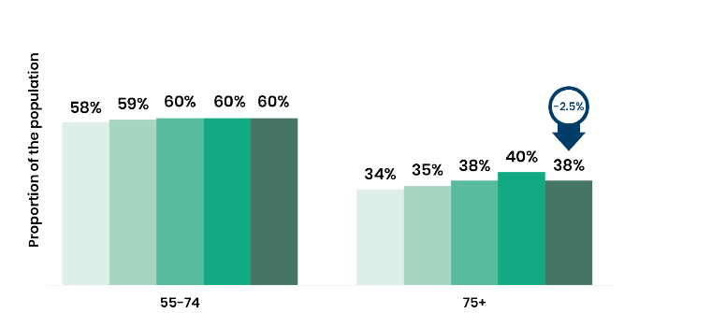
Sport England (2021) Active Lives, Adults Survey Percentage of people achieving 150+ minutes of PA/week

Slide 42
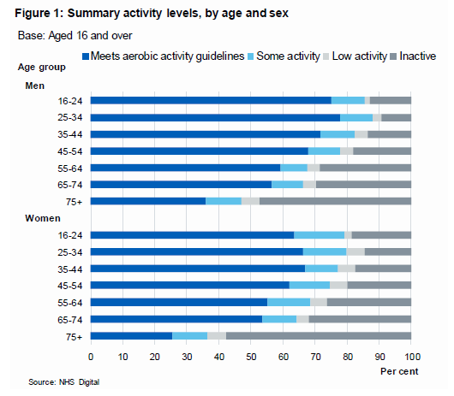
Statistics on obesity, PA &diet NHS Digital 2018

Slide 43
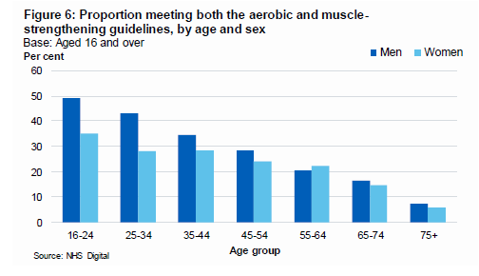
Statistics on obesity, PA &diet NHS Digital 2018

Slide 44
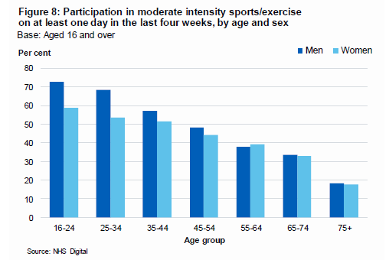
Statistics on obesity, PA &diet NHS Digital 2018

Slide 45
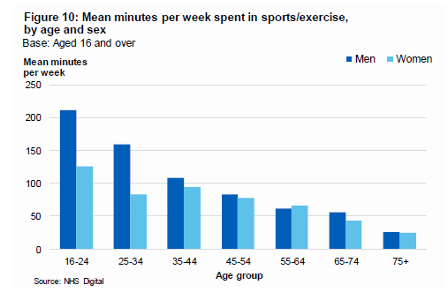
Statistics on obesity, PA &diet NHS Digital 2018

Slide 46
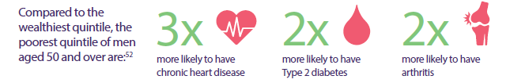
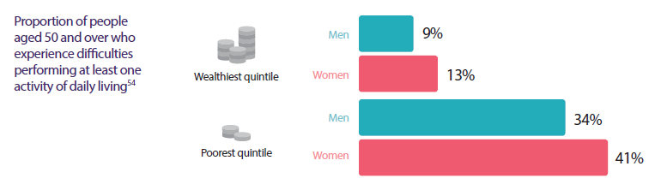
The State of Ageing in 2019 Centre for Better Ageing. Ageing and inequalities

Slide 47

Key points
No interventions including exercise actually make you live longer
However, regular PA increases average life expectancy due to its effect on chronic disease development
PA preserves functional capacity
Aerobic and resistance exercise training increases aerobic and muscle strength by 20-30% in older adults
Regular PA improves overall psychological wellbeing

Slide 48
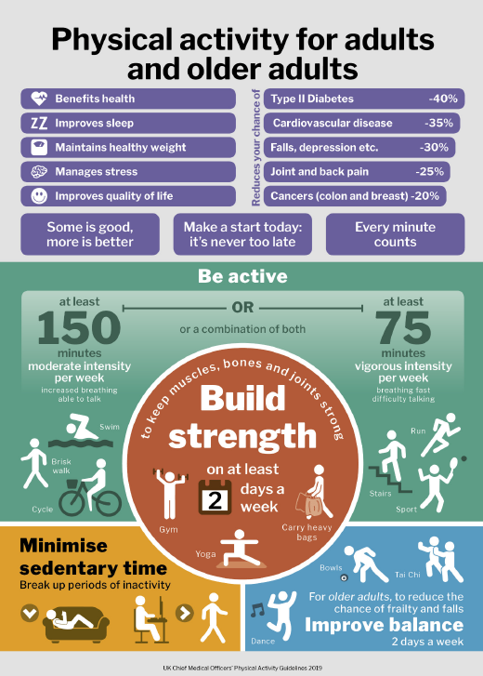

Slide 49
Muscle and bone strengthening and balance activities (MBSBA)
Activities of Daily Living (ADLs) generally require muscular strength and balance
Hence why resistance and balance exercise are included in the PA guidelines
Impaired muscular strength/power and balance associate with an increased risk of falls
Low bone density associated with an increased risk of fractures
Preserving musculoskeletal strength and power along with balance is a prerequisite for maintaining mobility and independent living during ageing
Hillsden and Foster (2018)

Slide 50
PA and falls risk
Community dwelling fall rates in 65-90 year olds:
Fallers/year - women 39%, men 30%
Recurrent fallers/year: women 14%, men 11%
Fall rates in nursing homes double than community dwellers
Fallers twice as likely to need hospitalisation
One third of falls result in serious injury
Resultant increase in fear of falling
Leads to deceased PA and social activates
Resulting decrease in strength, balance and independence
Schott and Tietjens 2019

Slide 51
PA and falls risk
Sensorimotor systems decline with ageing
Postural control declines - falls risk increases
Falls are not an inevitable part of ageing – they can be prevented. Poor muscle strength and balance are the two most common modifiable risk factors for falls
Centre for Better Ageing (2019)
210,000 falls-related hospital admissions per year in UK
PHE (2018)

Slide 52
PA and falls risk
Most effective PA intervention was standing dynamic activity 3 times a week for 3 months
Foster and Armstrong (2018)
PA as well as social support and falls efficacy reduces fall risk in assisted living
Schott and Tietjens (2019)
Highest fall risk at lowest level of PA in community dwellers
Soares et al. (2019)

Slide 53
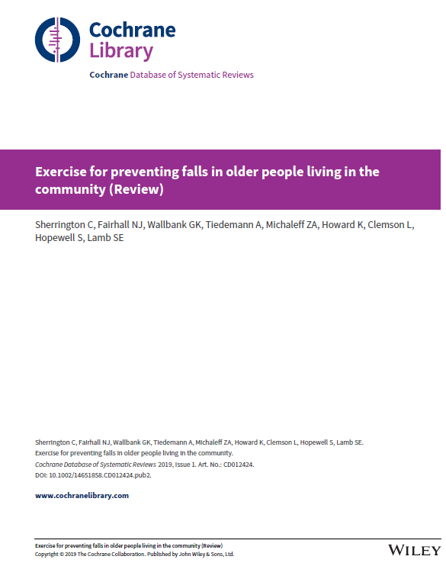
PA and falls risk
Cochrane Systematic Review (Sherrington et al. 2019)
Exercises that target gait, balance and muscle strength have been found to prevent falls
81 different types of PA programme were reviewed
Falls outcomes analysed (rate of falling and number of fallers)
Most effective were those involving balance and functional exercises
Tai Chi also beneficial
Uncertain effect of resistance only, dance and walking

Slide 54
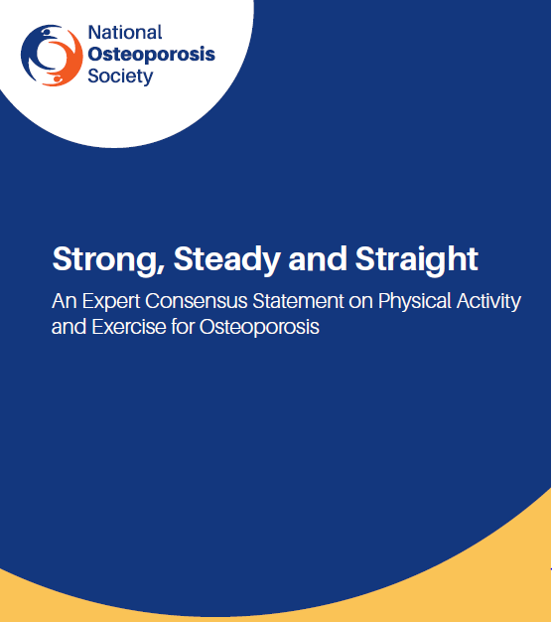
PA and osteoporosis
Osteoporosis – low bone mineral density
“Brittle bones”
Osteoporotic fractures cost the NHS £4.4billion/year
Previous misconceptions around PA – e.g., avoid high-impact, lifting weights and forward-bending
People with osteoporosis should be encouraged to do more not less PA
PA not associated with harm , e.g., vertebral fractures – benefits outweigh risks
Those with the lowest bone density may have the greatest potential to improve

Slide 55
PA and dementia
Dementia is a group of symptoms that may include memory loss, difficulties in thinking, problem-solving or language, and often changes in mood, perception or behaviour.
Most common types are vascular dementia and Alzheimer’s disease
PA has protective benefit
Higher levels more protective
Delays and reduces severity of symptoms
Geda et al. (2010)
Being physically active in mid-life protects against dementia and dementia subtypes in old age
Najar et al. (2019)

Slide 56
PA and Parkinson’s disease (PD)
PD is a progressive neurological condition
Classic symptoms include tremors, limb rigidity, poor balance and lack of control over movements
No cure
Prevention and stabilisation of condition important
PA is protective against PD progression
As was coffee, caffeinated tea, moderate alcohol use
Smoking and heavy alcohol consumption increased risk
Paul et al. (2019)

Slide 57
PA and Parkinson’s disease (PD)
PD results in cognitive impairments which reduce quality of life
Cognitive impairment can worsen and evolve into Alzheimer’s disease
Aerobic exercise has been shown to have beneficial effects
HIIT improved immediate auditory memory and attention and sustained attention
Acute aerobic exercise was able to promote better cognitive performance
Fiorelli et al. (2019)

Slide 58
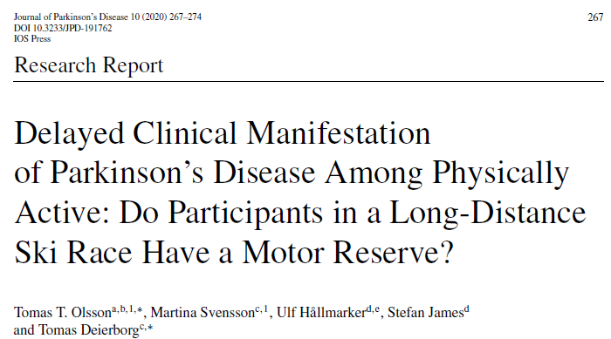
PA and Parkinson’s disease (PD)
Physically active cross-country skiers were followed over time (21 years) to see the effects of their activity on PD
PD symptoms developed later
Symptoms were less severe
Same level of brain pathology but limit to symptom development suggests the concept of a ‘motor-reserve’
Potential protective benefit of PA
Olsson et al. (2020)

Slide 59
PA preferences in older adults
Systematic review by Amireault, Baier and Spencer (2019)
Walking was the most preferred mode of activity for >65s
Preference to engage in continuous PA for ~ 30 minutes
Preference for exercising alone decreases with age
Social context important
Health promotion implications

Slide 60
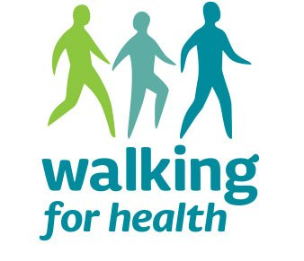
Walking
Free walking groups, with or without leaders
Over 4,000 groups across England
70,000 regular walkers
10,000 volunteers
Recommended by NICE (PH16) for mental wellbeing

Slide 61
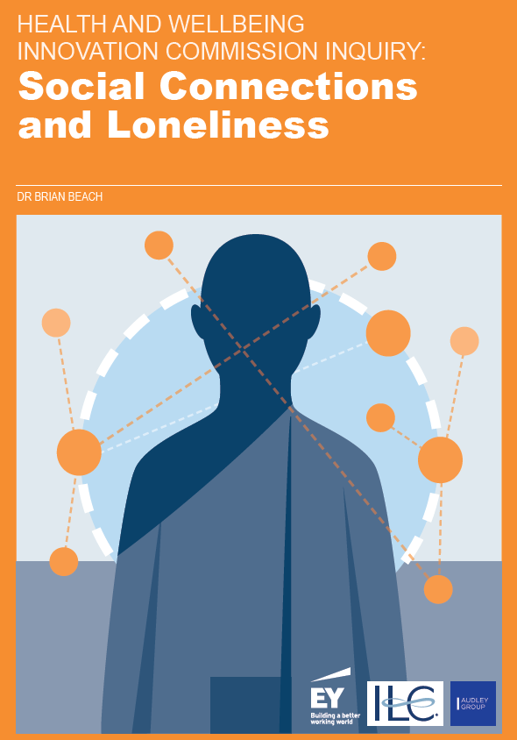
Social isolation & loneliness
Increasing recognition that social connections are important for health and wellbeing in later life
Protects against loneliness and isolation
50% excess risk of CHD
7 times more likely to report low life satisfaction
3 times more likely to report unhappiness
3.4 times the rate of depression
Loneliness and health estimated to be equivalent to smoking 15 cigarettes a day
PA and leisure activates play a major role in providing social connections and in protecting against the above conditions
Health and Wellbeing Innovation Commission (2018)

Slide 62

Local leisure services provider

Slide 63
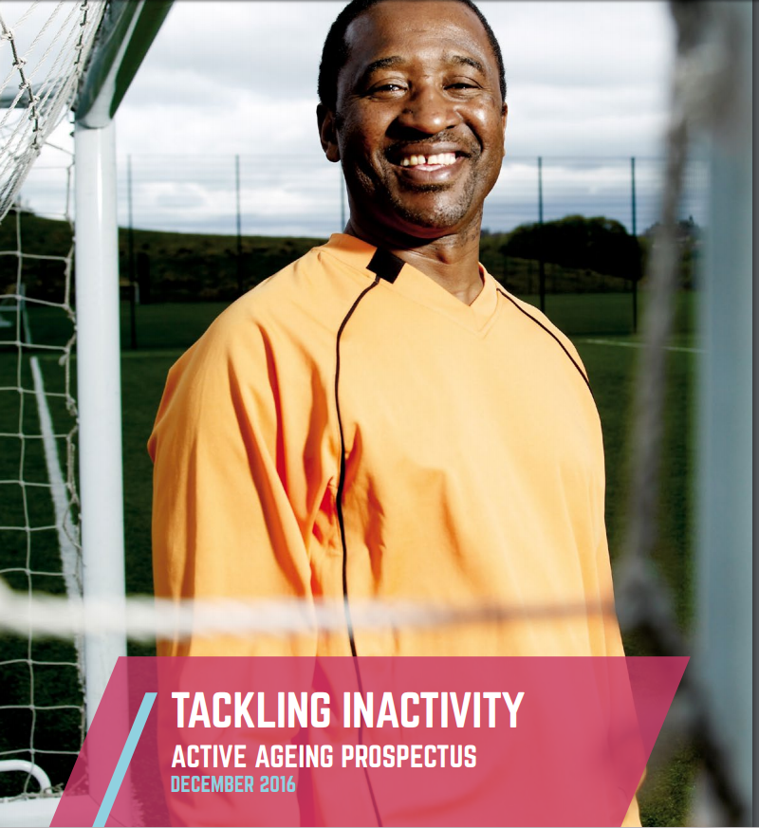

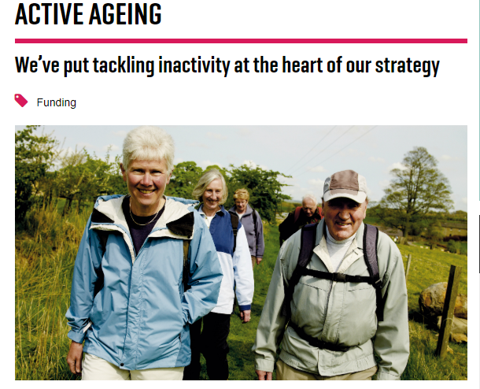

Slide 64
Changing the focus of PA promotion for older people
Disease prevention
Maintenance of
independence
Age

Slide 65
Review of learning outcomes
Discuss the importance of promoting PA throughout the lifespan.
Identify the benefits and discuss evidence supporting PA in:
Children and young people.
Pregnancy and post-partum.
Older people.

Slide 66
References
Amireault, S., Baier, J. and Spencer, J. (2019) Physical activity preferences among older adults: a systematic review, Journal of Ageing and Physical Activity, 27 pp128-139
British Association of Sport and Exercise Sciences (2020) The BASES expert statement on the importance of fundamental movement skills for children’s physical activity and health. The Sport and Exercise Scientist, 66 (winter 2020)
Camacho-Minano, M., LaVoi, N. and Barr-Anderson, D. (2011). Interventions to promote physical activity among young and adolescent girls: A systematic review. Health Education Research, 26(6), 1025-1049.
Colleran, H., Hiatt, A., Wideman, L. and Lovelady, C. (2019) The effect of an exercise intervention during early lactation on bone mineral density during the first year postpartum, Journal of Physical Activity and Health, 16, pp. 197-204.
Dobbins, M., DeCorby, K. and LaRocca, R. (2013). School-based physical activity programs for promoting physical activity and fitness in children and adolescents aged 6-18. Cochrane Database of Systematic Reviews, 2.
Erikson, E. (1998). The Life Cycle Completed. Norton.
Fiorelli et al. (2019) Differential acute effect of high-intensity interval or continuous moderate exercise on cognition in individuals with Parkinson’s disease, Journal of Physical Activity and Health, 16, pp. 157-164.
Foster and Armstrong (2018), What types of physical activity are effective in developing muscle and bone strength and balance? Journal of Frailty, Sarcopenia and Falls, 3 (2), pp. 58-65.
Geda, Y et al. (2010). Physical exercise, ageing, and mild cognitive impairment: A population-based study. Archives of Neurology, 67(1) p. 80-6.
Hillsden and Foster (2018), What are the health benefits of muscle and bone strengthening and balance activites across life stages and specific health outcomes? Journal of Frailty, Sarcopenia and Falls, 3 (2), pp. 66-73.

Slide 67
References
Izumi, B. et al. (2015) Leading behaviours, group cohesion, and participation in a walking group program. American Journal of Preventative Medicine. 49 (1), pp. 41-49
Najar, J. et al. (2019) Cognitive and physical activity and dementia, a 44-year longitudinal population study of women, Neurology, 92: e1-e9
Paul et al. (2019) The association between lifestyle factors and Parkinson’s disease progression and mortality, Movement Disorders, 34 (1), pp 58-66.
Pearson, N., Braithwaite, R. and Biddle, S. (2014). The effectiveness of interventions to increase PA among adolescent girls: A meta-analysis. Academic Pediatrics.
Ridgers, N., Stratton, G., Fairclough, S. and Twisk, J. (2007). Long-term effects of playground markings and physical structures on children’s recess physical activity levels. Preventive Medicine, 44(5), 393-397.
Soares et al (2019) Physical activity levels and risk of falling in community dwelling older adults: systematic review and meta-analysis, Journal of Ageing and Physical Activity 27, pp.34-43
Schott, N. and Tietjens, M. (2019)Exploring the mediating role of social support and fall efficacy on the association between falls and physical activity: a cross-sectional study in an assisted living population, , Journal of Ageing and Physical Activity 27, pp.53-60
Sherrington, C. et al. (2019) Exercise for preventing falls in older people living in the community (review), Cochrane Database of Systematic Reviews. Issue 1 DOI: 10.1002/14651858.CD012424.pub2.
Smith, R. et al. (2018) Infographic: physical activity for pregnant women. British Journal of Sports Medicine. 52 (8) p532-533
Sport England (2021) Active Lives Adult Survey, May 2020/21 Report. Available at: https://sportengland-production-files.s3.eu-west-2.amazonaws.com/s3fs-public/2021-10/Active%20Lives%20Adult%20Survey%20May%202020-21%20Report.pdf?VersionId=YcsnWYZSKx4n12TH0cKpY392hBkRdA8N (Accessed 11 March 2022)
Stodden et al. (2008) A developmental perspective on the role of motor skill competence in physical activity: an emergent relationship, Quest, 60 (2), pp. 290-306
Van Sluijs, E., McMinn, A. and Griffin, S. (2007). Effectiveness of interventions to promote physical activity in children and adolescents: Systematic review of controlled trials. British Medical Journal, 335, 703-707.

